Slide 1
Made you look!
Preattentive attributes and visual design
Sean Oslin
DRAFT 1 10/12/19

Slide 2
What are preattentive attributes?
Pre - before
Attentive - what you see or notice on a conscious level
Attributes - characteristics
Notes:
Definition: Visual property which is processed in spatial memory without our conscious action.
Think: immediate, instinctive, automatic
Or, what your eye is drawn to

Slide 3
Guess how fast your brain processes PAA?
5 seconds?
.5 seconds?
.05 seconds?
.005 seconds?

Slide 4
4 preattentive visual properties
Color

Slide 6
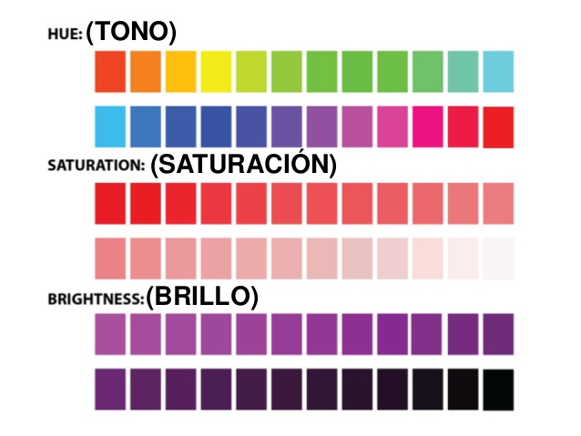
Notes:
Let’s explore what we mean by these 3 concepts. Hue is a measure of the color that we give a name to such as “Red” or “Violet”. Saturation and lightness are a measure of color intensity.
Hues and intensities are preattentively processed and can be used to separate visual elements from their surroundings.
This saves the user from having to perform a visual search through data.

Slide 7
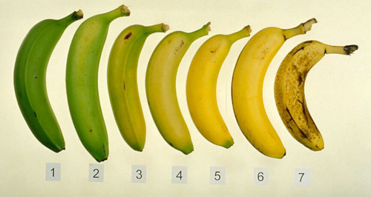
Hue: how ripe are my bananas?
Notes:
Hue is the easiest color concept to understand.
Example of how hue changes during the ripening process.
What number represents your ideal eating banana? Making banana bread?

Slide 8
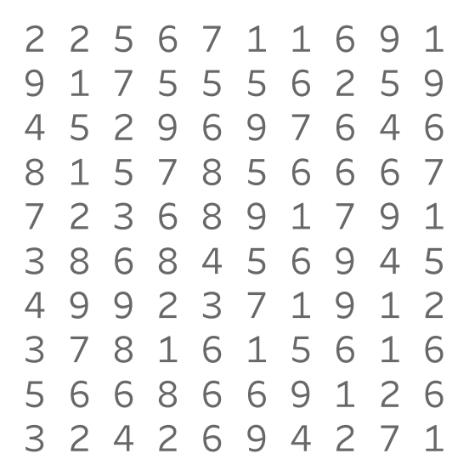
How many 9s?

Slide 9
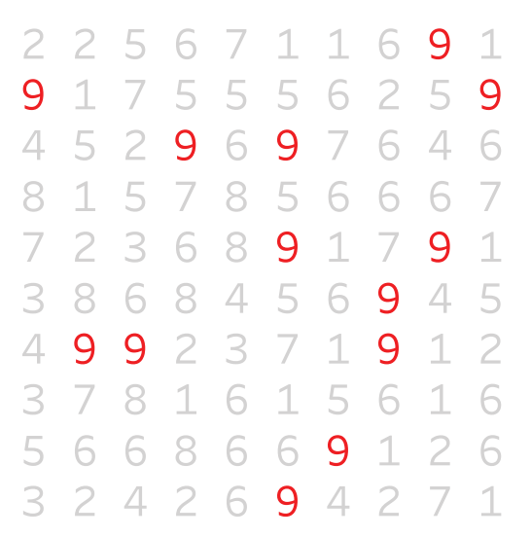
Easier?
Notes:
Our eyes are drawn to the color.

Slide 10
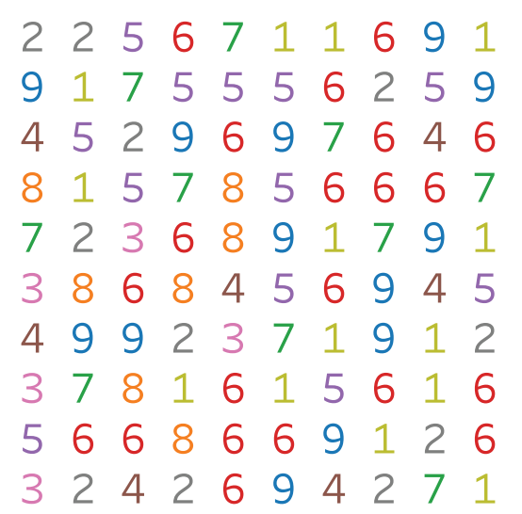
How about now?
Notes:
Too much color is as bad as none at all.
Remember: colors are accents. Also, black is an accent color in visualizations.

Slide 11
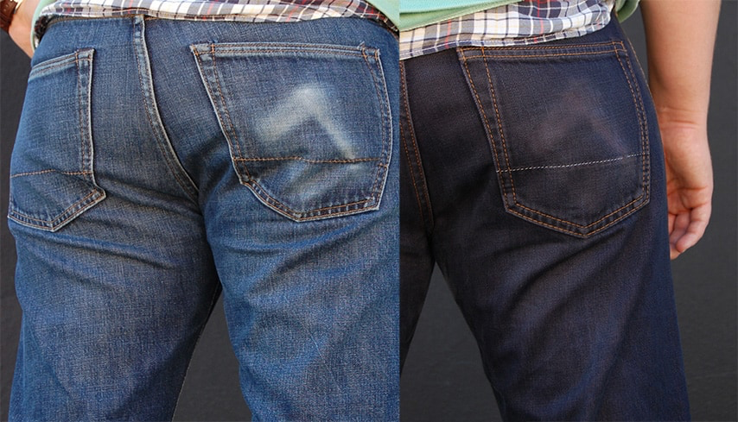
Saturation: same hue, different intensity
Notes:
Color saturation is the intensity of a hue. It is the amount of grey in a color.
Maximum saturation is pure color. Minimum is washed out, faded, pastel, etc.
Why does saturation matter? Our eyes are drawn to pure, intense colors. Also, using a continuum of saturations for a single color allows us to add variety to a presentation without overwhelming our eyes with too many colors.

Slide 12
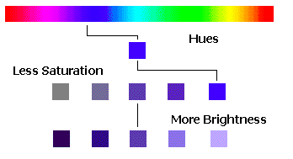
Brightness: it’s black & white
Notes:
Brightness is the relative lightness or darkness of a particular color, from black (no brightness) to white (full brightness). Brightness is also called Lightness in some contexts. In Tableau, saturation is called Opacity and is measure as a percent.
The difference between saturation and brightness is very important in photography and image processing applications. It is less important in creating visualizations using charts and graphs.
The takeaway: if you want turn a blue sky grey, lessen the saturation. If you want to make a dark blue sky a lighter shade of blue, increase the brightness.

Slide 13
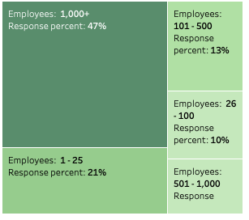
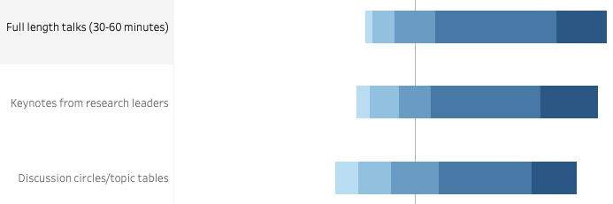
Using brightness to convey information
Notes:
In these examples, brightness is coupled with geometric area to convey information about the relative strength/size/importance of each data element

Slide 14
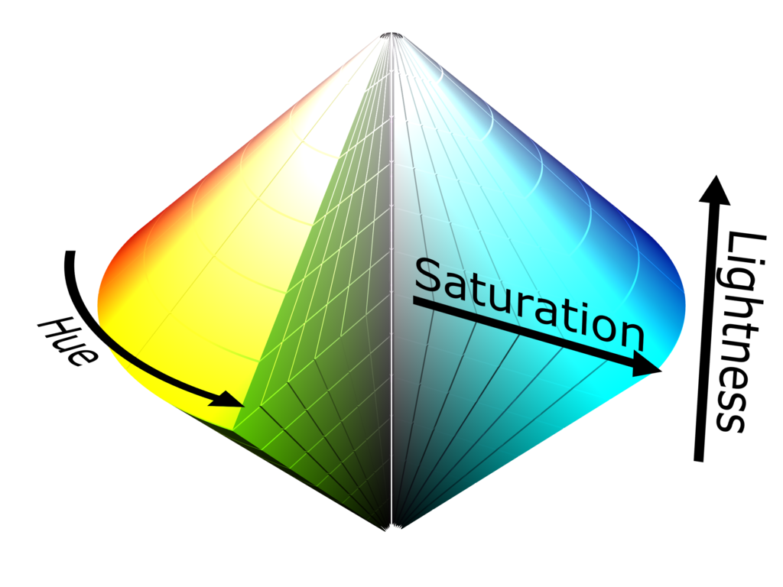
Hue, saturation, brightness (lightness)

Slide 15
Takeways
Colors are for emphasis, accent - use sparingly
Contrast is good
Black is an accent color

Slide 16
Form
Form can be manipulated to either call attention to a member of the data set or to reduce our attention on it.

Slide 17
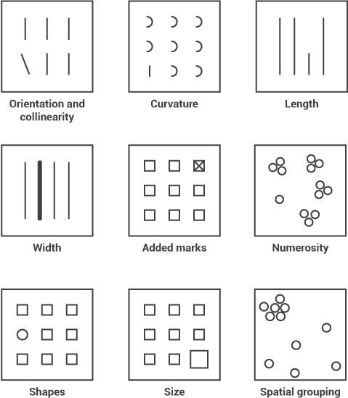
What seems to be missing?

Slide 18
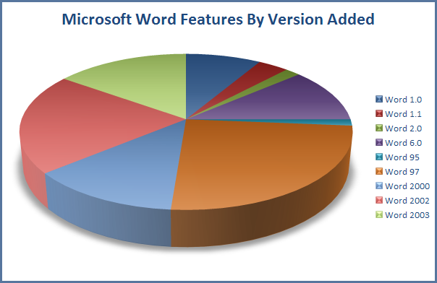
No, NO, NO!!!!
Proportions
and 3D
(also, too much color and no labels)
What would be a better chart type?

Slide 19
